Slide 1
“BLOG WEBSITE”
Task - 3

Slide 2

Your Project Name
Your Project Introduction
S.NO | LMS Username | Name | Batch
1 | @Kiruthika2806 | Kiruthika S | 3
2 | @Saradha1103 | Saradha M | 3
3 | @Devikumar1302 | Devi K | 3
4 | @Lakshmi22062003 | Lakshmi M | 3

Slide 3
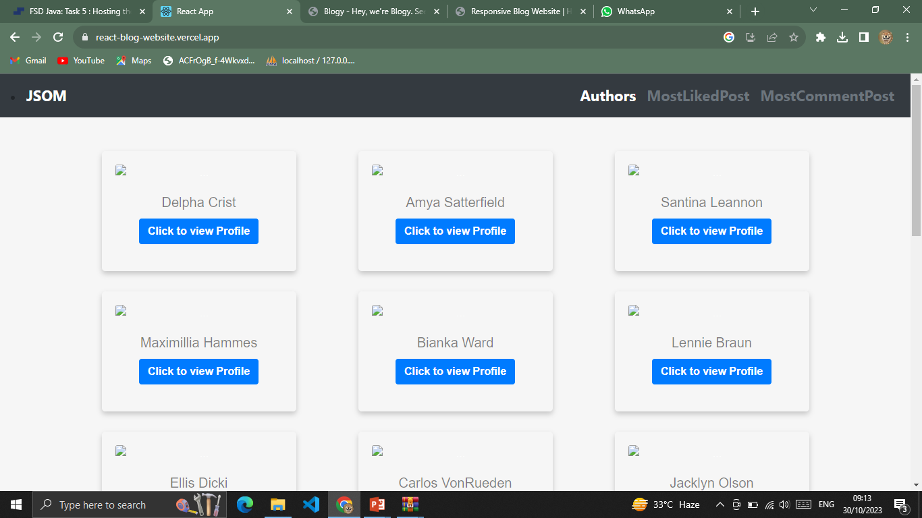
Task 3 :: Frontend Creation
Create various Front End Programs

Slide 4
Step-Wise Description
* In this project we created a frontend page with react and then we can post our blog in the page .
* And then we can like the post comment the post and all the actions we can did using the website.
Summary of your task
The main topic or focus of your blog (e.g., travel, technology, health, etc.).
Any specific themes or subtopics you frequently cover.
The tone or style you prefer for your blog (e.g., informative, conversational, formal, etc.).
Any unique features or aspects of your blog that you'd like to highlight.

Slide 5
Assessment Parameter
Create folder structure for HTML application
Render Conditional components
Write Functions for event handling
Check-List
Overall UI of the project
Handling broken links
Optimizing render cycle

Slide 6
Submission Github
https://github.com/Kiruthika2806/NM-AIT-GROUP3

